Slide 1
AI
Understanding AI
Concepts, Tools & Future Scope
A practical guide for beginners and builders alike

Slide 2
What is AI?
Artificial Intelligence is software that learns patterns from data and makes decisions or predictions on its own — instead of following only rules a programmer wrote in advance.
T
Traditional Software
Follows fixed, hand-written rules. Same input always gives the same output.
A
AI Software
Learns patterns from examples and adapts its output as new data arrives.
In short: AI systems improve with experience, not just instructions.

Slide 3
Core Concepts
The building blocks behind most modern AI systems
ML
Machine Learning
DL
Deep Learning
Algorithms that find patterns in data and improve at a task with experience.
A branch of ML using many-layered networks to handle complex data like images and speech.
NN
Neural Networks
NLP
Natural Language
Layers of connected "neurons" loosely inspired by the brain, used to learn patterns.
Techniques that let machines read, understand, and generate human language.

Slide 4
How AI Learns
A simplified view of the training-to-use pipeline
1
2
3
4
Data
Training
Model
Inference
Large sets of examples are collected and cleaned — text, images, numbers.
A model repeatedly adjusts itself to reduce errors on that data.
The trained model stores learned patterns as numerical weights.
The model applies what it learned to new, unseen input in real time.

Slide 5
Popular AI Tools Today
A snapshot of widely-used tools across categories
CB
Chatbots & Assistants
IMG
Image Generation
ChatGPT, Claude, Gemini — conversational help with writing, research, and Q&A.
Midjourney, DALL-E, Stable Diffusion — turning text prompts into original artwork.
DEV
Coding Assistants
PRO
Productivity Tools
GitHub Copilot, Claude Code — suggesting, writing, and debugging code in real time.
AI-powered notes, spreadsheets, and scheduling that summarize and automate busywork.

Slide 6
AI in Everyday Life
Most people already use AI daily, often without noticing
S
Search
Ranking and understanding results beyond exact keyword matches.
R
Recommendations
Suggesting shows, songs, and products based on your behavior.
AI
V
Voice Assistants
Turning speech into action for reminders, calls, and searches.
A
Automation
Filtering spam, flagging fraud, and routing support tickets.

Slide 7
Future Scope
Where AI is headed over the next few years
AG
Autonomous Agents
MM
Multimodal AI
AI that plans multi-step tasks and uses tools on its own, not just answers questions.
Single systems that fluently combine text, images, audio, and video.
PR
Personalization
IM
Industry Impact
Assistants that adapt to individual habits, memory, and preferences over time.
Deeper integration into healthcare, education, science, and manufacturing.

Slide 8
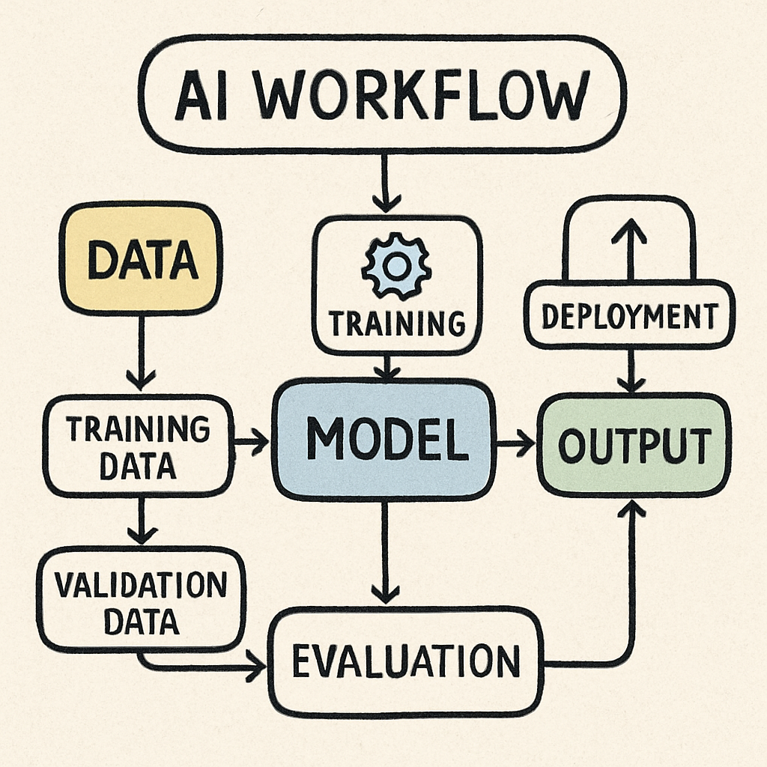
WORKFLOW
Using AI well means weighing its limits, not just its power
E
J
A
R
Jobs & Workforce
Bias in training data can produce unfair or skewed outcomes.
Automation shifts some roles and creates demand for new skills.
Models can sound confident while being factually wrong.
Human review and clear policies matter as AI takes on more tasks.

Slide 9
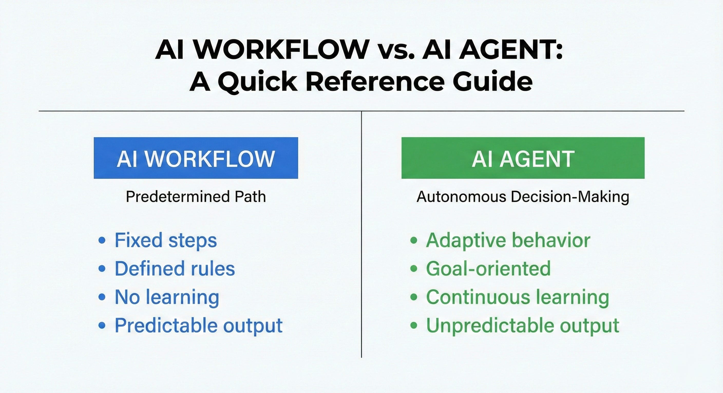
WORKFLOW
Using AI well means weighing its limits, not just its power
E
J
A
R
Jobs & Workforce
Bias in training data can produce unfair or skewed outcomes.
Automation shifts some roles and creates demand for new skills.
Models can sound confident while being factually wrong.
Human review and clear policies matter as AI takes on more tasks.

Slide 10
Challenges & Considerations
Using AI well means weighing its limits, not just its power
E
J
A
R
Ethics & Fairness
Jobs & Workforce
Accuracy & Bias
Responsible Use
Bias in training data can produce unfair or skewed outcomes.
Automation shifts some roles and creates demand for new skills.
Models can sound confident while being factually wrong.
Human review and clear policies matter as AI takes on more tasks.

Slide 11
conclusion
Artificial Intelligence has evolved from rule-based systems into powerful technologies capable of learning from data, understanding language, interpreting images, generating content, and supporting complex workflows.
AI is already being used in healthcare, education, business, environmental monitoring, entertainment, transportation, and everyday applications.
The future of AI will depend not only on increasing technical capabilities but also on responsible development, reliable data, privacy, security, transparency, and meaningful human oversight.
T
A
AI Software
In short: AI systems improve with experience, not just instructions.

Slide 12
The takeaway
AI isn't magic — it's pattern recognition at scale, and it's becoming an everyday tool, not just a technology.
Thank you

